Slide 1
PHP Development in 2018
Brisbane Laravel | Mick Davies | @_mickdavies

Slide 2

Just Digital People
Sponsor

Slide 3
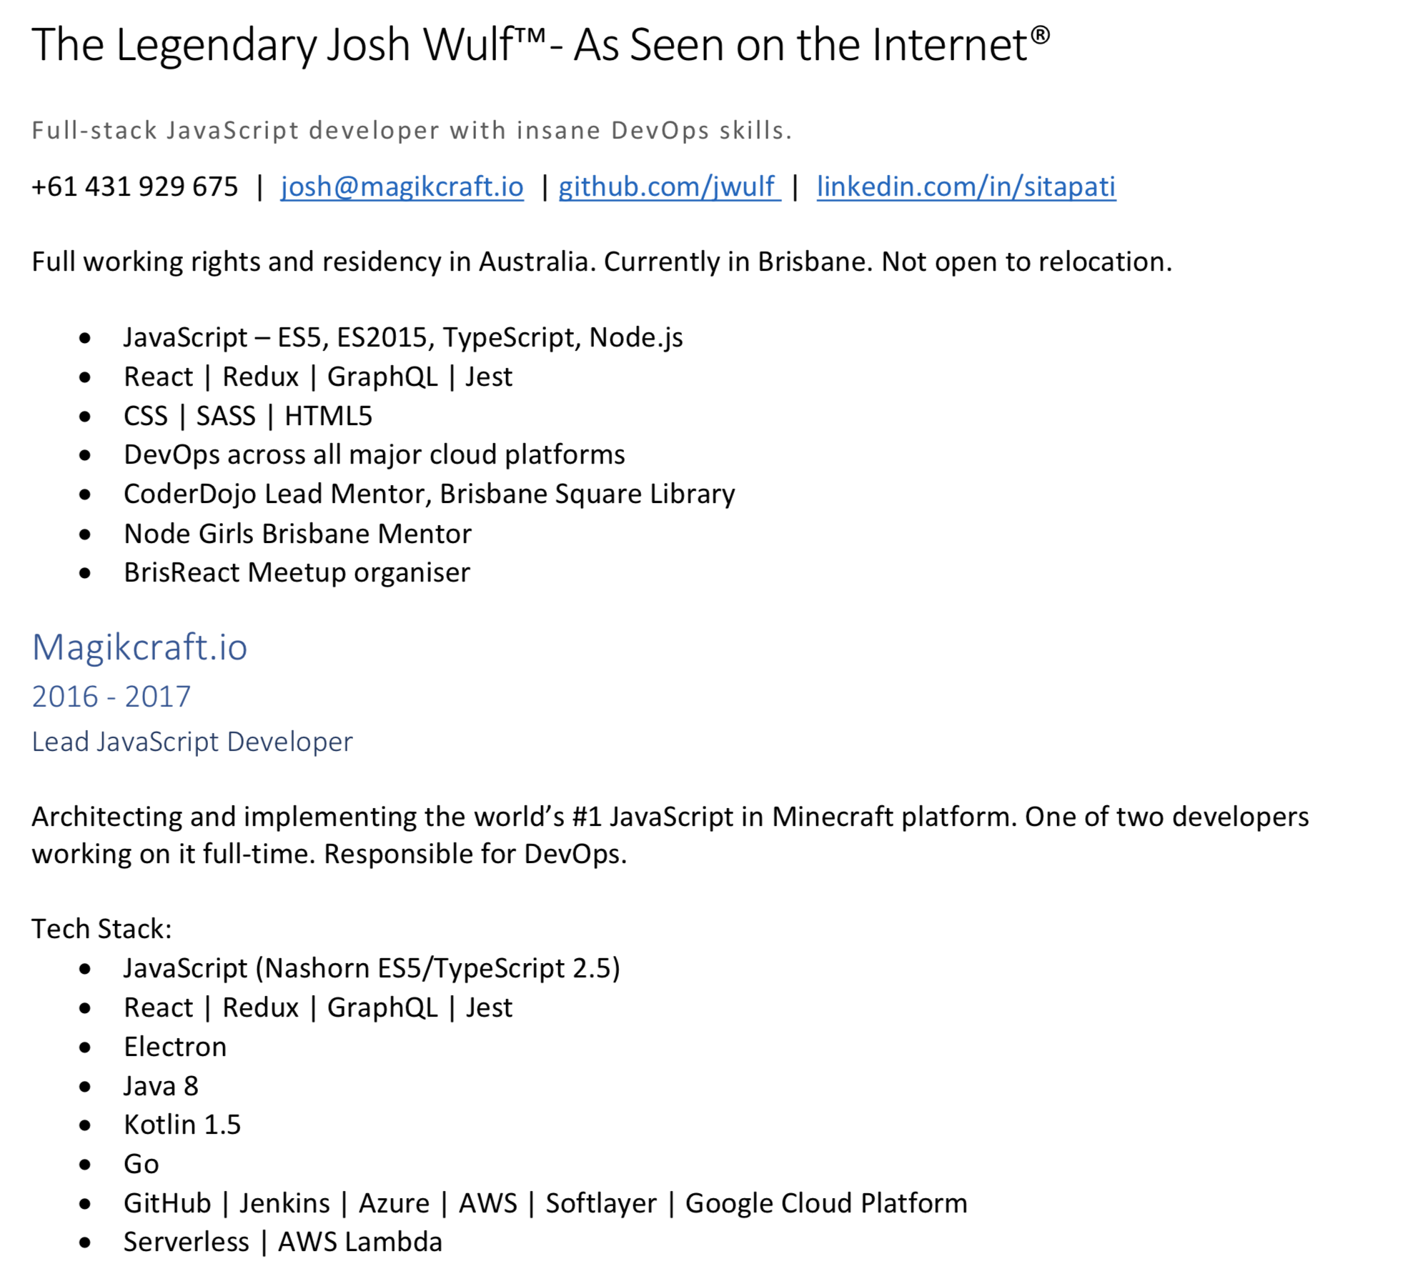




Slide 4

Finally.
We Are Back

Slide 5
What New Skills Do I Need In 2018?
Overview

Slide 6
What’s new in 5.5

Slide 7

Bug Fixes for 2 years
L5.5 (LTS)

Slide 8
No Need To Update App.php file
Auto Package Discovery

Slide 9
Sayonara Fractcal
API Resources

Slide 10
https://laravel.com/docs/5.5/releases

Slide 11
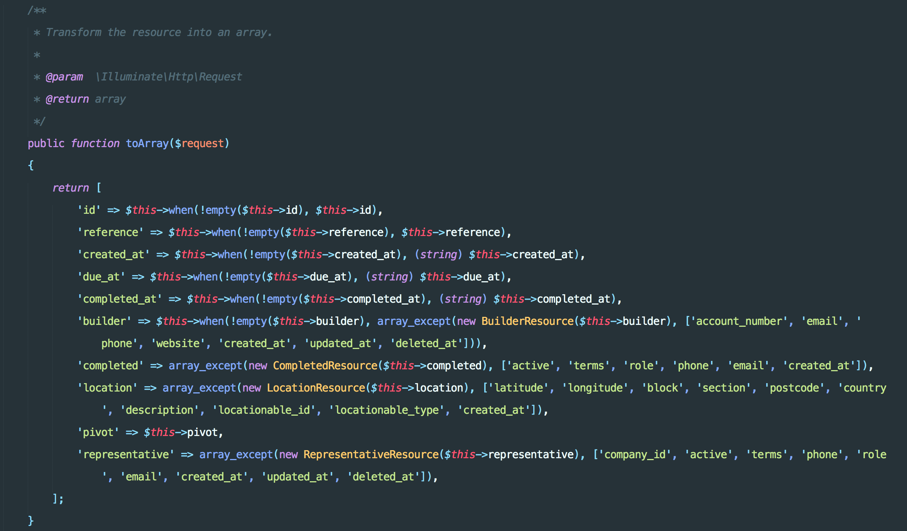

Slide 12
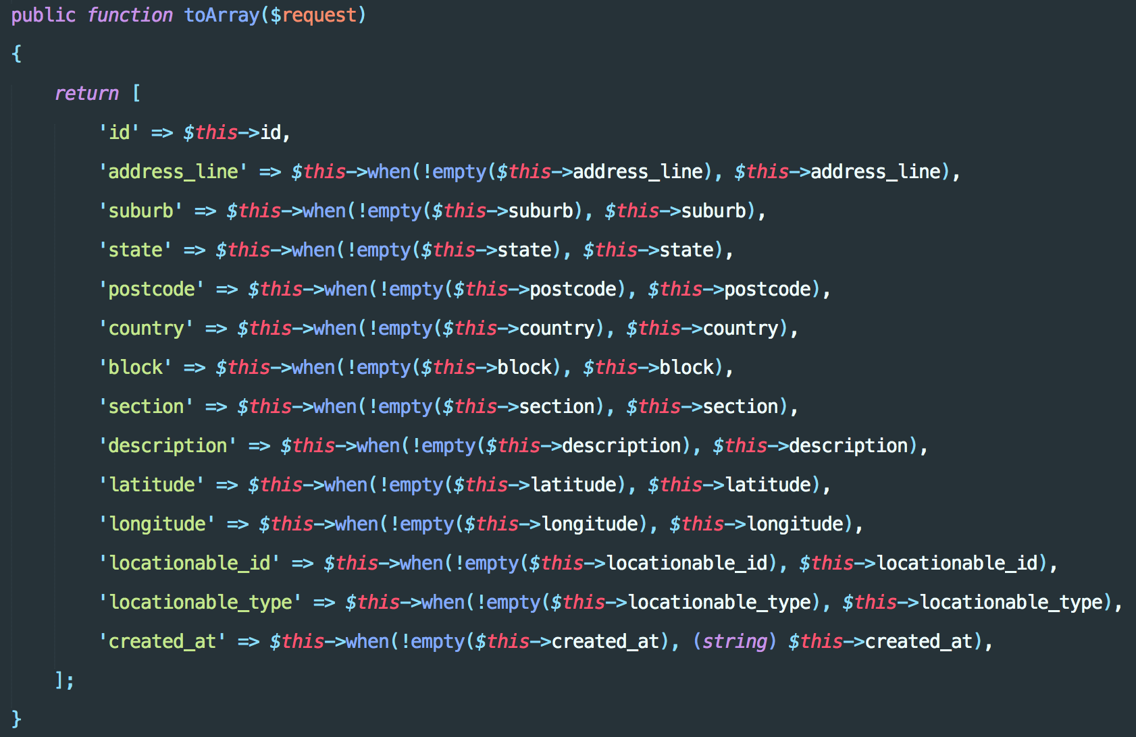

Slide 13
Monolith or MicroServices?

Slide 14

Technical overhead
New Tech Stack (Hashicorp / Kubernetes / Mesos)
Lumen (missing many useful Artisan commands)
Logging & Monitoring
Reflects Organisation Structure (conway’s law)
Pros & Cons
Fast Prototyping
Lower Complexity
Simple deployments
Minimal Reflection on Organisation

Slide 15
Kubernetes

Slide 16

Resource Allocation
Replication Fallback
Companies Can benefit immensely
Developer-Devops (All In One)
Orchestration | Deployment

Slide 17
Php 7.x

Slide 18

7.1 Stable In Production
Benchmarks
Upgrade

Slide 19
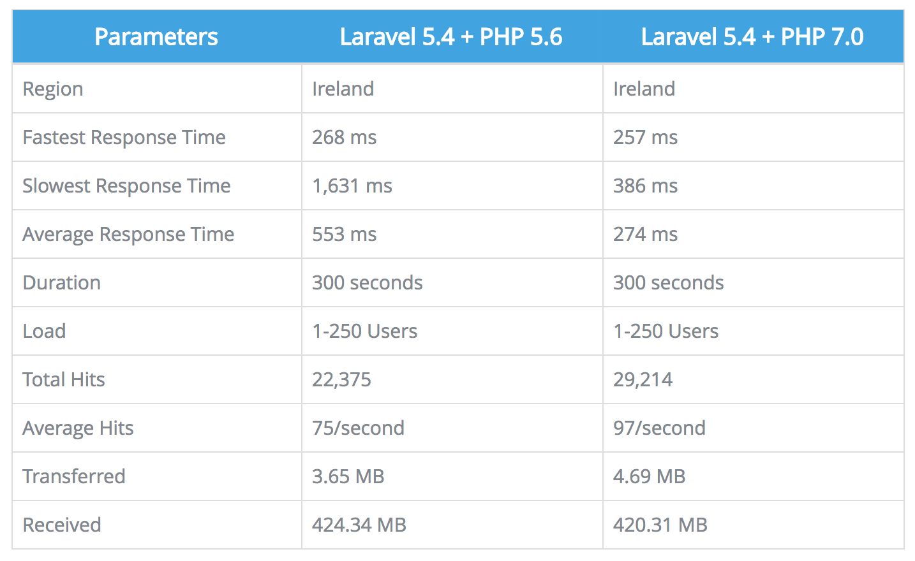
https://www.cloudways.com/blog/laravel-5-benchmarks-php-5-6-and-7/

Slide 20
Vue / React

Slide 21

L5.5 Supports both Vue.js & React out of the box
Beautiful Integration

Slide 22

Vue.js Exceptionally Easy To start
relatively low learning curve
Promotes best practices in JS
Many Packages available on NPM
Beginner to Advanced

Slide 23
https://laravel.com/docs/5.5/mix

Slide 24
Bootstrap / Foundation / Component Styles

Slide 25

Component based CSS Styles
Don’t Get caught up
Bootstrap 4 newly released
DO we need a CSS Framework anymore?

Slide 26
Code Editors
Simply Put, Don’t Waste Time!

Slide 27
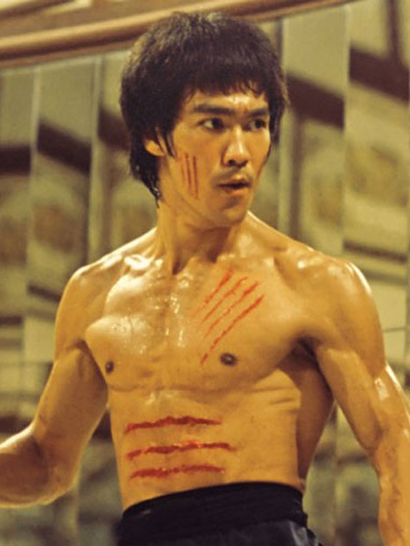
Atom (Slow, what happened?)
PHP Storm (Slow, but Good Intellisense)
VS Code (super popular, Very Modular)
Sublime Text (Old Faithful)
Be Fast, stay fast

Slide 28

Languages
Tools | Frameworks

Slide 29

GoLang (efficient, clean, Blazing Fast)
Node.js (Plenty of resources)
Python (Scales well, Good for ML)
Machine Learning Libraries (Tensor Flow, R, Scikit)
Mental Investment

Slide 30
Roadmap
Meetup Group

Slide 31


Slide 32
Questions | Discussion

Slide 33

What do you want to cover?
Questions For You

